Slide 1

LSB STEGANOGRAPHY
ANTONY SUSANI
ID:2217152
SUB TO:PRO GRACE KENNEDY
​

Slide 2
CONTENTS
INTRODUCTION
ADVANTAGES
HOW IT WORKS
CODE
CONCLUSION

Slide 3
WHAT IS STEGANOGRAPHY?
This is a technique involves hiding sensitive information within an ordinary, non-secret file or message, so that it will not be detected. The sensitive information will then be extracted from the ordinary file or message at its destination, thus avoiding detection.
It comes from the Greek words steganos, which means “covered” or “hidden,” and graph, which means “to write.” Hence, “hidden writing.”

Slide 4
EXAMPLES OF STEG ACTIVITY
Writing with invisible ink
Embedding text in a picture (like an artist hiding their initials in a painting they’ve done)
Backward masking a message in an audio file (remember those stories of evil messages recorded backward on rock and roll records?)
Concealing information in either metadata or within a file header
Hiding an image in a video, viewable only if the video is played at a particular frame rate
Embedding a secret message in either the green, blue, or red channels of an RRB image

Slide 5
ADVANTAGES
Steganography is a form of encryption that protects the information within a message and the connections between sender and receiver.
The three essential elements of steganography—security, capacity, and robustness—make it worthwhile to covert information transfer via text files and develop covert communication channels.
You can store an encrypted copy of a file containing sensitive information on the server without fear of unauthorized parties gaining access to the data.
Government and law enforcement agencies can communicate secretly with the help of steganography corporations.

Slide 6
LSB IMAGE STEGANOGRAPHY
LSB Steganography is an image steganography technique in which messages are hidden inside an image by replacing each pixel’s least significant bit with the bits of the message to be hidden.
To understand better, let’s consider a digital image to be a 2D array of pixels. Each pixel contains values depending on its type and depth. We will consider the most widely used modes — RGB(3x8-bit pixels, true-color) and RGBA(4x8-bit pixels, true-color with transparency mask). These values range from 0–255, (8-bit values).

Slide 7
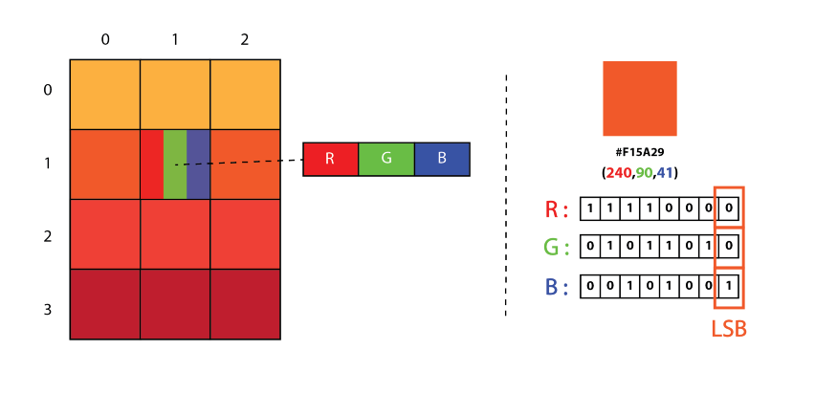

Slide 8
We can convert the message into decimal values and then into binary, by using the ASCII Table. Then, we iterate over the pixel values one by one, after converting them to binary, we replace each least significant bit with that message bits in a sequence.
To decode an encoded image, we simply reverse the process. Collect and store the last bits of each pixel then split them into groups of 8 and convert it back to ASCII characters to get the hidden message.

Slide 9
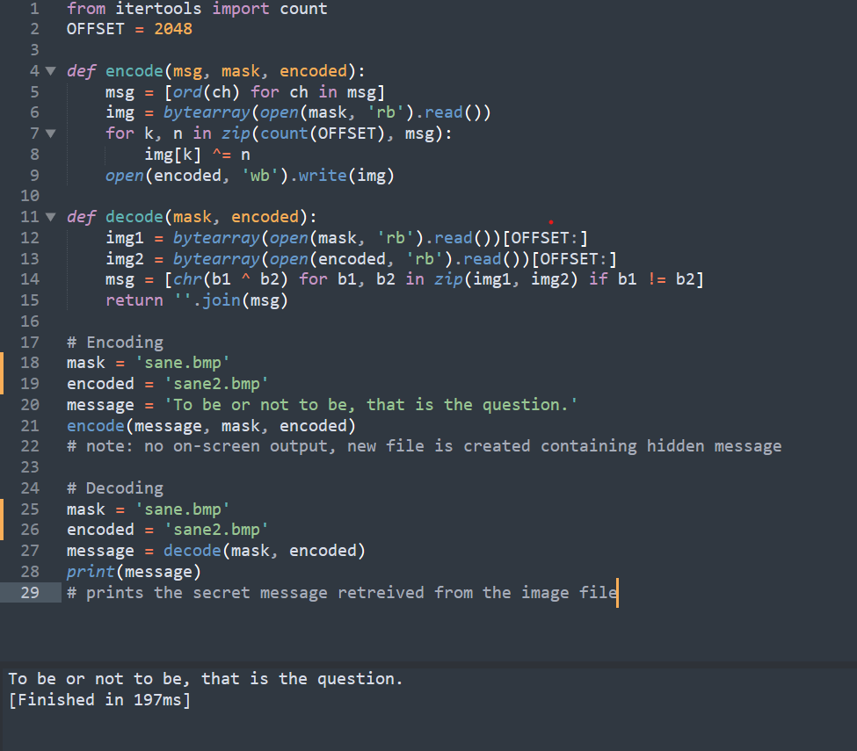
CODE

Slide 10
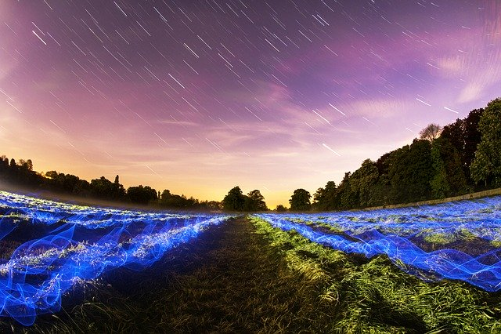

sane.bmp
Sane-enc.bmp
The picture below show two picture which is a plain picture and an encoded picture

